Slide 1

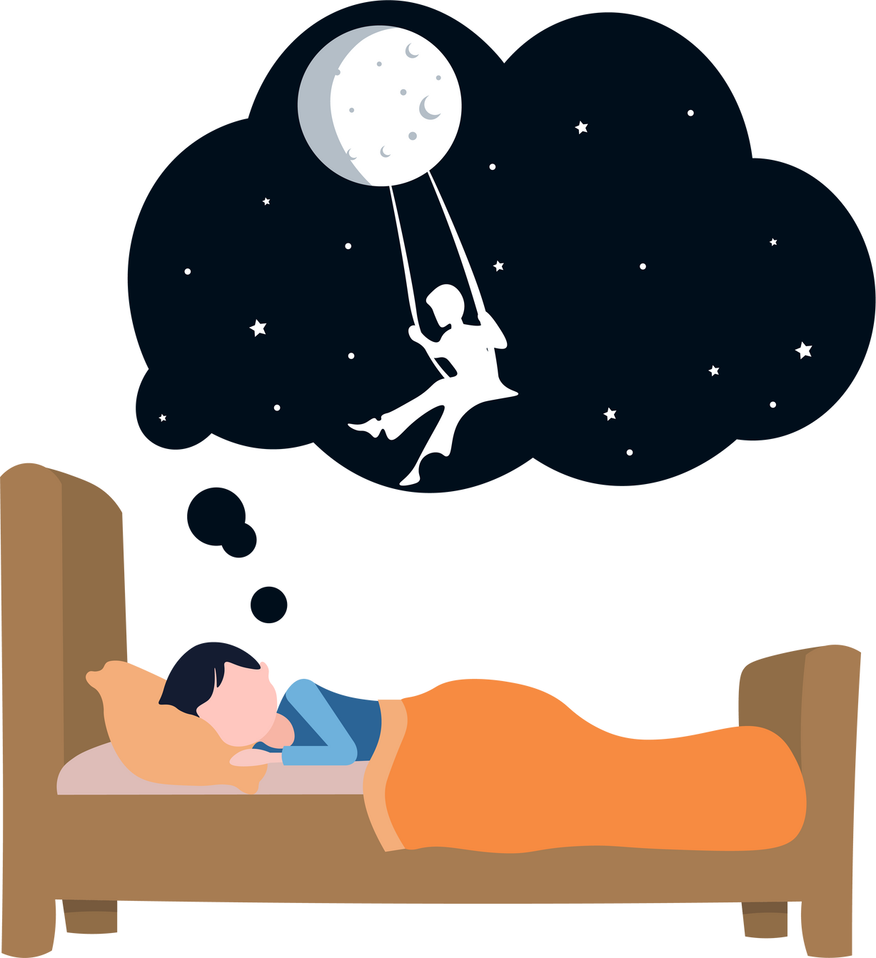


DREAMS-THE SECRET
WORLD OF SLEEP
Michegar
Michegar
Where science meets the soul
BY
SUPRIYA R

Slide 2





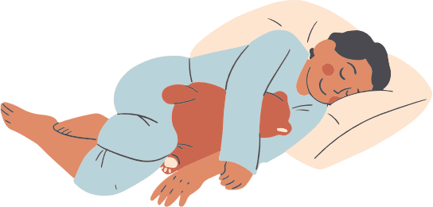
What are dreams?
Dreams are stories, images and emotions that appear in our mind while we sleep
They can be happy, scary, funny or strange
Everyone dreams – even if we don’t remember it!
We dream for about 2 hours each night.

Slide 3



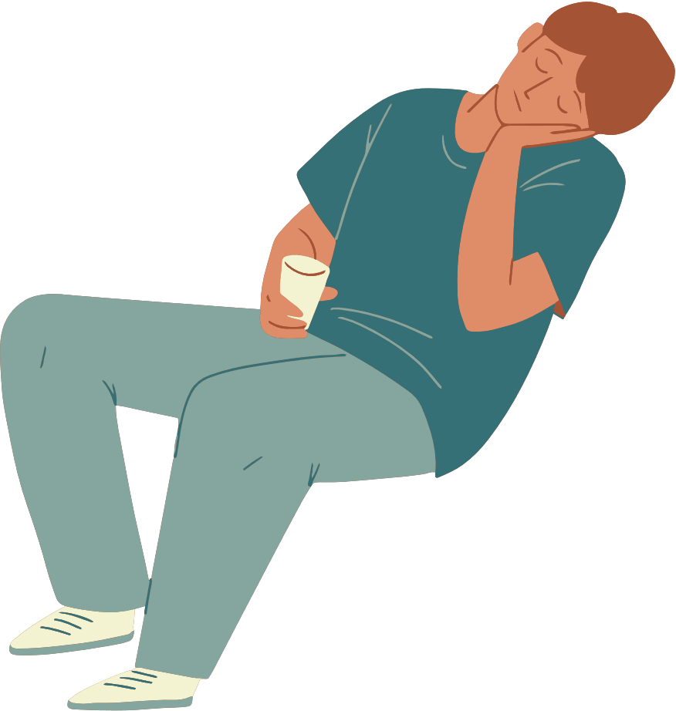
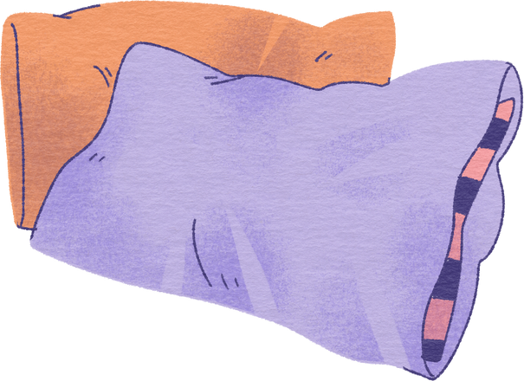
Why do we dream?(scientific view)
Memory sorting – The brain organizes the day’s experience
Problem solving – Helps us find creative ideas
Emotional healing – Release stress and feelings
Einstein said – ‘Imagination is more important than knowledge

Slide 4

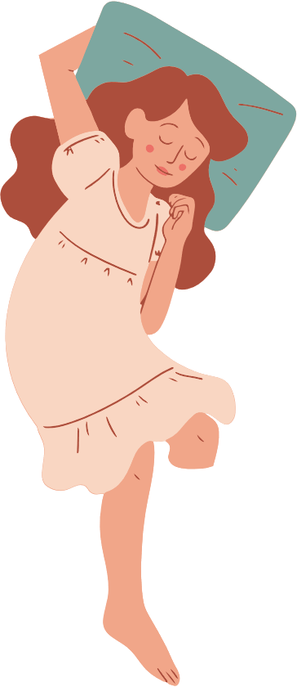


Types of Dreams
Normal dreams – Random images or events
Lucid dreams – You realize you’re dreaming
Nightmares – Scary dream from fear of stress
Recurring Dreams – The same dream repeated

Slide 5



Dreams and the soul (mystical beliefs)
Many cultures believe the soul travels during sleep
Egyptians: The ‘Ba’ (soul) left the body to visit other realms
Indian texts: The soul experiences higher planes in dreams
Astral projection Theory: The soul temporarily leaves the body to explore the ‘astral world’.

Slide 6



Conclusion
Dreams connect our mind, emotion and imagination
Whether brain signals or soul journeys they reveal human consciousness’s mystery
When our body sleeps, maybe our soul begin to explore

Slide 7


THANK YOU
Q AND A SESSION

